Slide 1
Art Haus

Slide 2
Who are we?
Project Description: A gallery space for people who can’t afford a gallery, and want to showcase their work. They are limited to 5 words for their image post. It also has their profile. They may also have a page dedicated to the art in question.

Slide 3
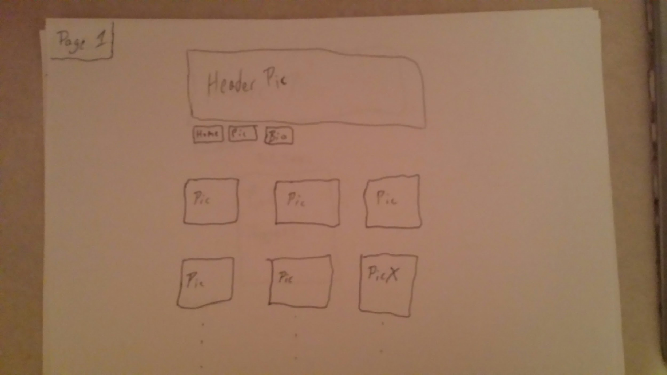
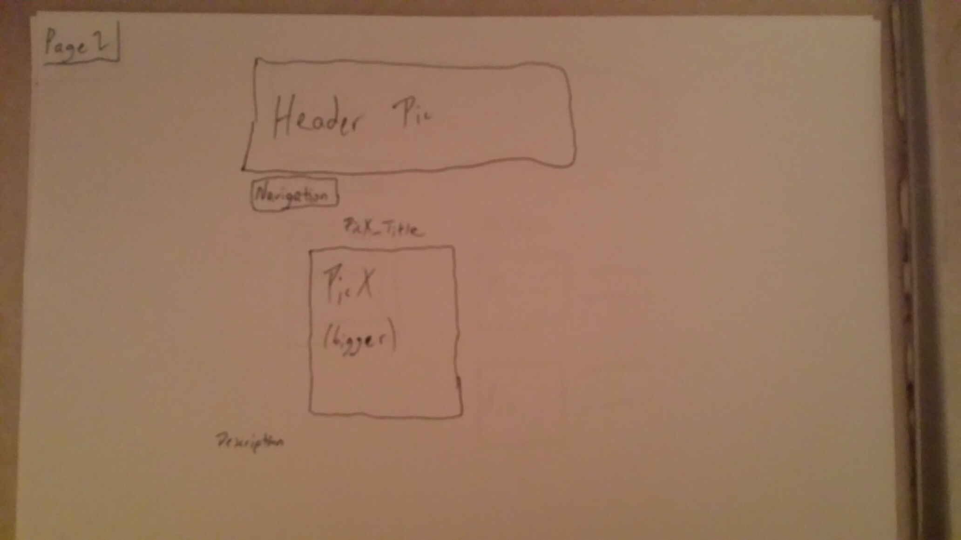
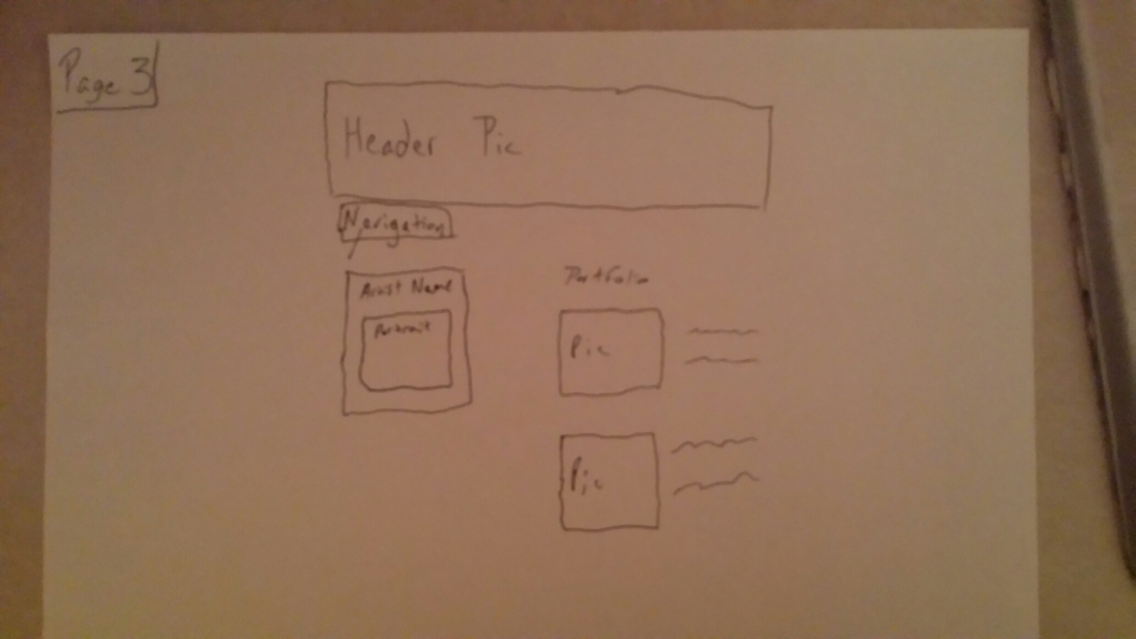
Initial Design
These are the schematics

Slide 4
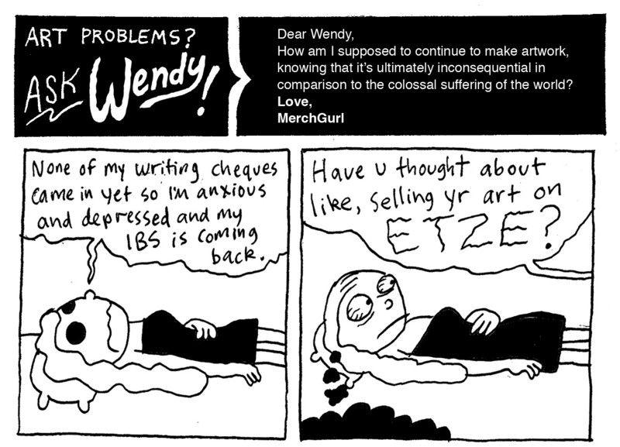
Who is the user?

Slide 5
A Walk through of the Website
The Front page
The Art Page
The Profile

Slide 6
Design
Why we decided to utilize divs as the major blocking sequence
We knew we couldn’t use tools to make it look better, such as HTML 5, and Bootstrap
The UI would have to be simple, and intuitive. These are artists.
Utilization of classes, and selectors in order to cut down on time

Slide 7
Div example
CSS
.grid-element {
width: 340px;
height: 340px;
float: left;
border: 1px solid black;
margin: 40px;
text-align: center;
background-color: white;
}
HTML
<div id="grid">
<a href="SharkPiece.html" ><div class="grid-element">
<img class="productImage" src="../resources/lana.jpg" alt="nope"/>
<h2>Love, Death, Pain</h2>
</div> </a>
<a href="SharkPiece.html"><div class="grid-element">
<img class="gifImage" src="../resources/shark.gif" alt="nope"/>
<h2>Parents, amirite?</h2>
</div>
</a>
<a href="SharkPiece.html"><div class="grid-element">
<img class="productImage" src="../resources/point.jpg" alt="nope"/>
<h2>But I have a point</h2>
</div>

Slide 8
Q/A?

